Slide 1
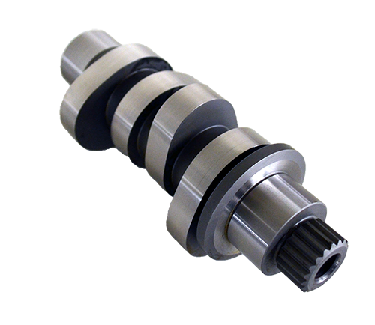
Kinematics and Dynamics
Day 05 | MP 3010
Cam and Follower
Development of Cam Profile

Slide 2
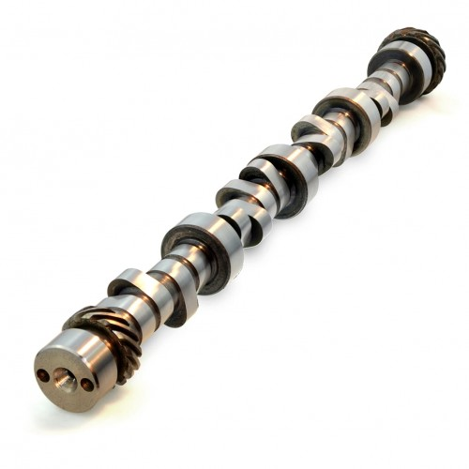
Cams
Section 1

Slide 3
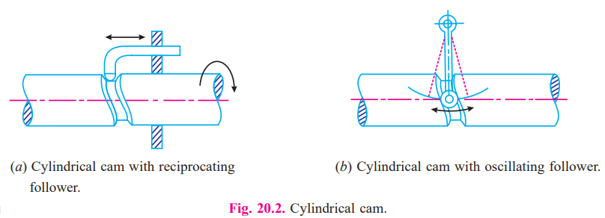
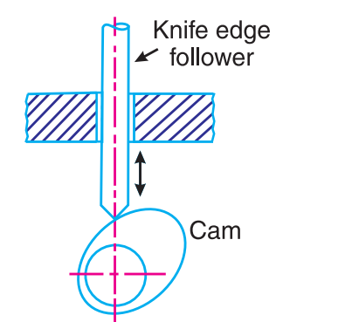
Classification of Cams

Slide 4
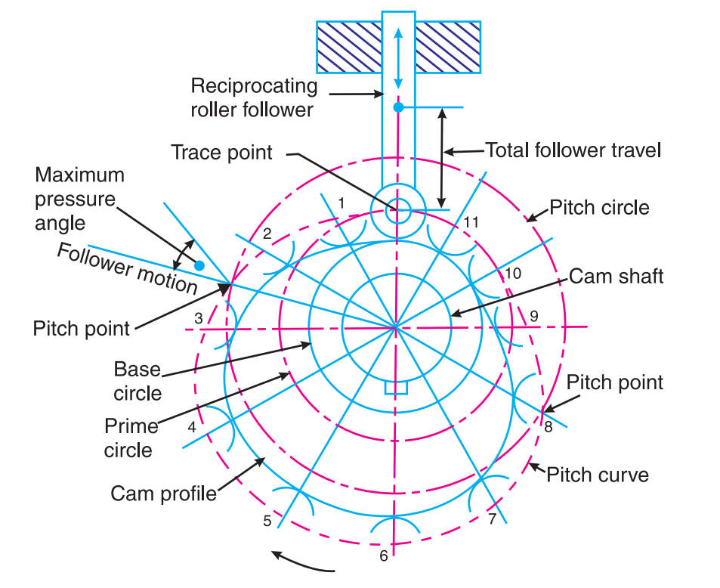
Terms

Slide 5
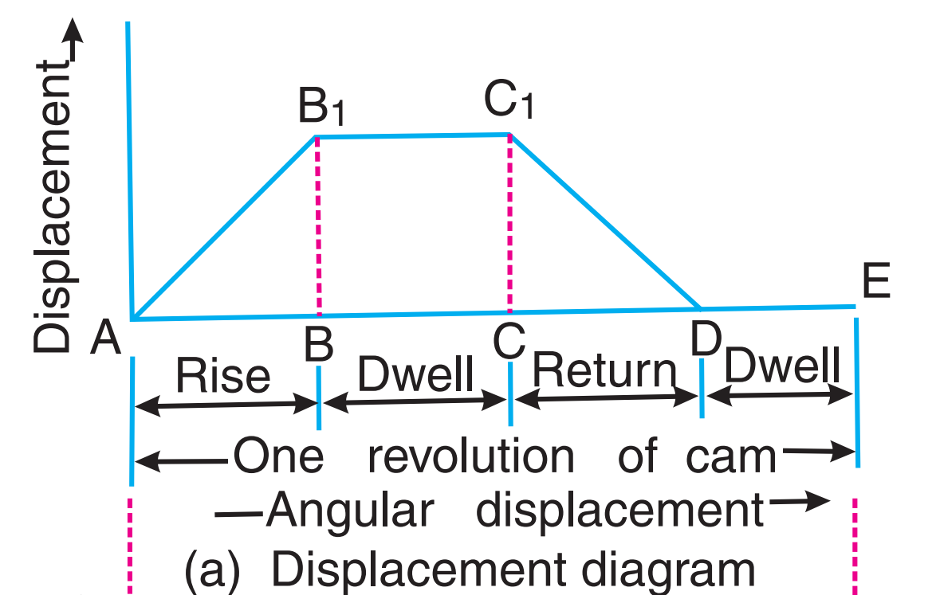
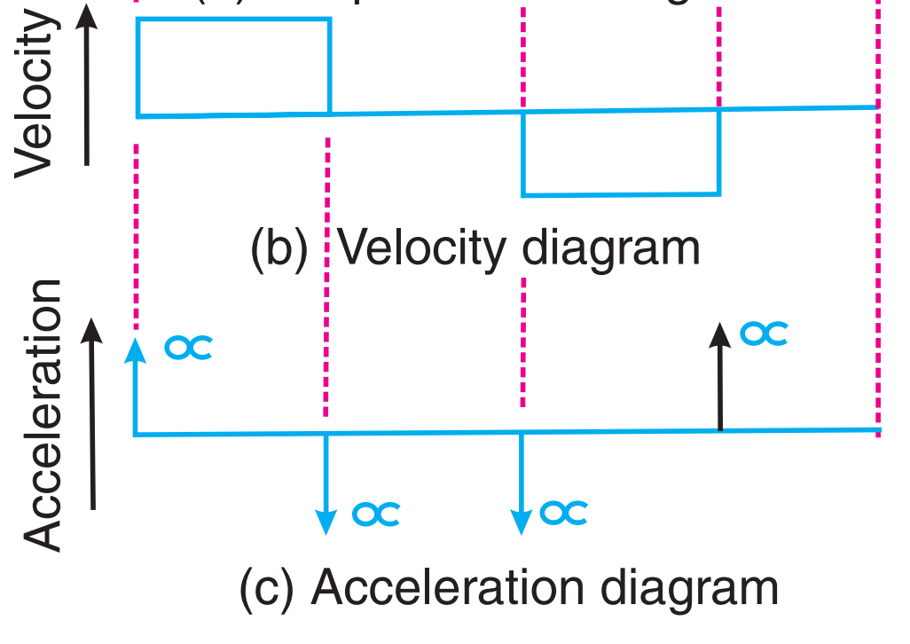
Displacement, Velocity and Acceleration Diagrams when the Follower Moves with Uniform Acceleration and Retardation

Slide 6
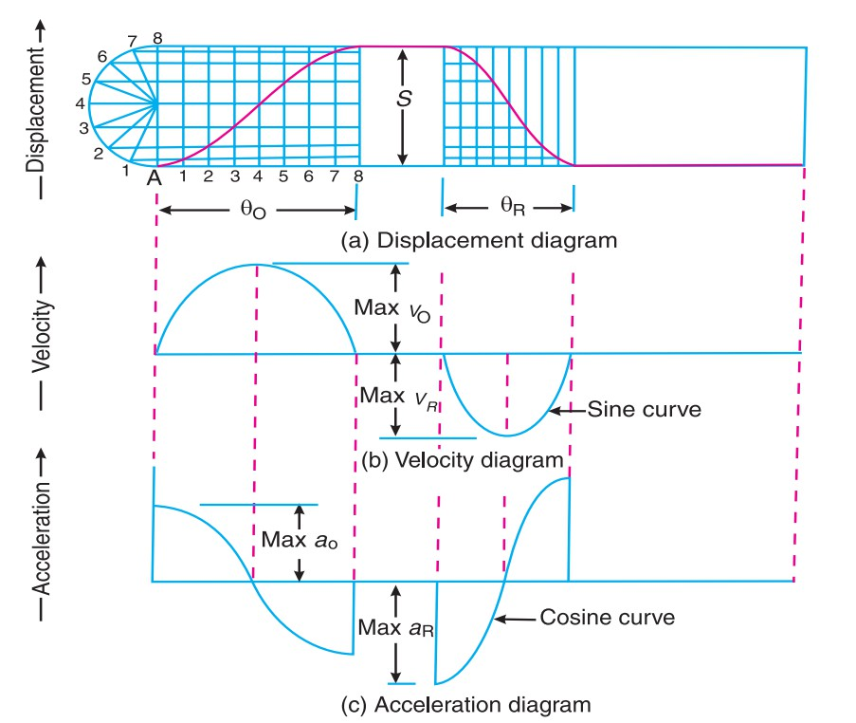
Displacement, Velocity and Acceleration Diagrams when the Follower Moves with Simple Harmonic Motion

Slide 7
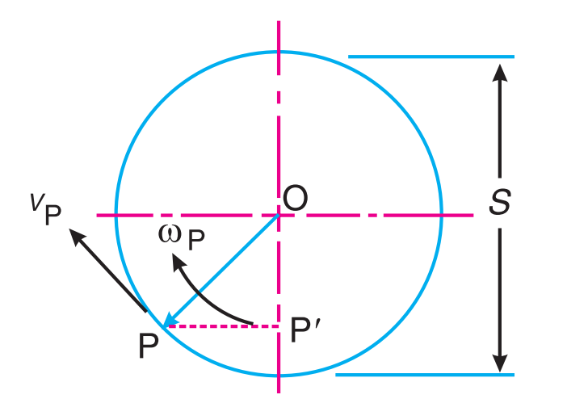
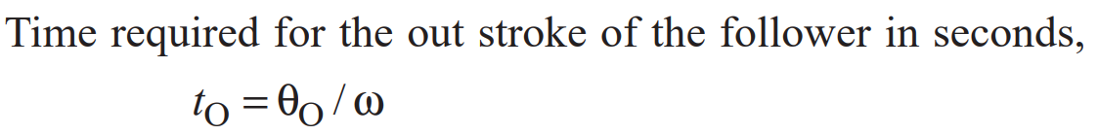
Analysis of cam and follower motion
Let
S = Stroke of the follower,
θ_{O} and R_{θ} = Angular displacement of the cam during out stroke and return stroke of the follower respectively, in radians, and
ω = Angular velocity of the cam in rad/s.

Slide 8
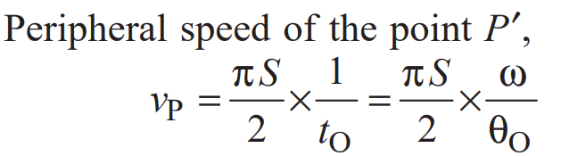
Peripheral Speed

Slide 9
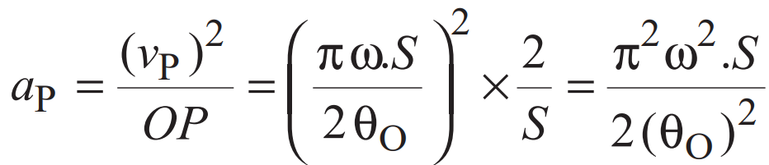
Centripetal acceleration of the point P

Slide 10
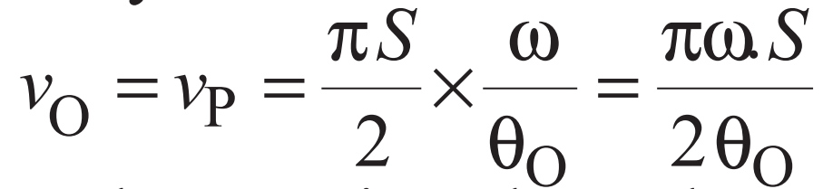
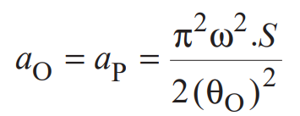
Maximum velocity and acceleration of the follower on the outstroke

Slide 11
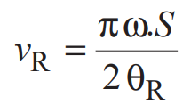
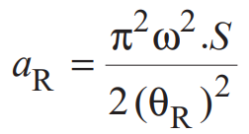
Maximum velocity and acceleration of the follower on the return stroke

Slide 12
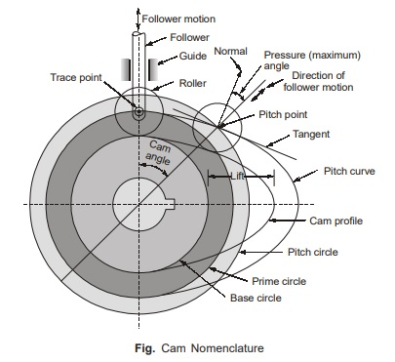
Development of cam profile
Section 2

Slide 13
A cam is to give the following motion to a knife-edged follower : 1. Outstroke during 60° of cam rotation ; 2. Dwell for the next 30° of cam rotation ; 3. Return stroke during next 60° of cam rotation, and 4. Dwell for the remaining 210° of cam rotation. The stroke of the follower is 40 mm and the minimum radius of the cam is 50 mm. The follower moves with uniform velocity during both the outstroke and return strokes. Draw the profile of the cam when (a) the axis of the follower passes through the axis of the cam shaft, and (b) the axis of the follower is offset by 20 mm from the axis of the cam shaft.

Slide 14
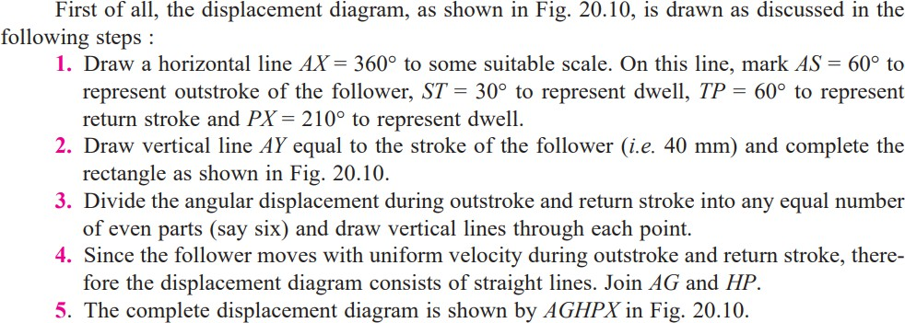
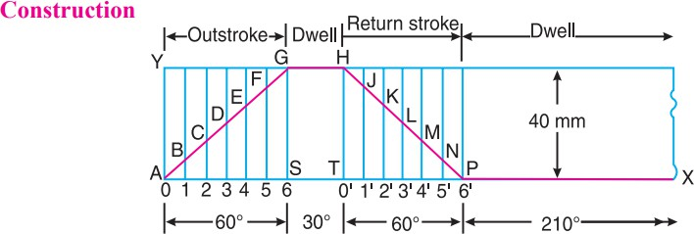

Slide 15
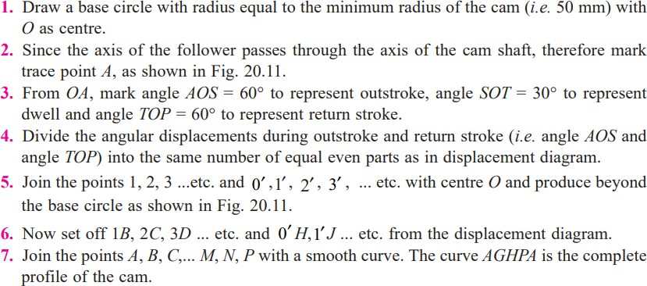

Slide 16
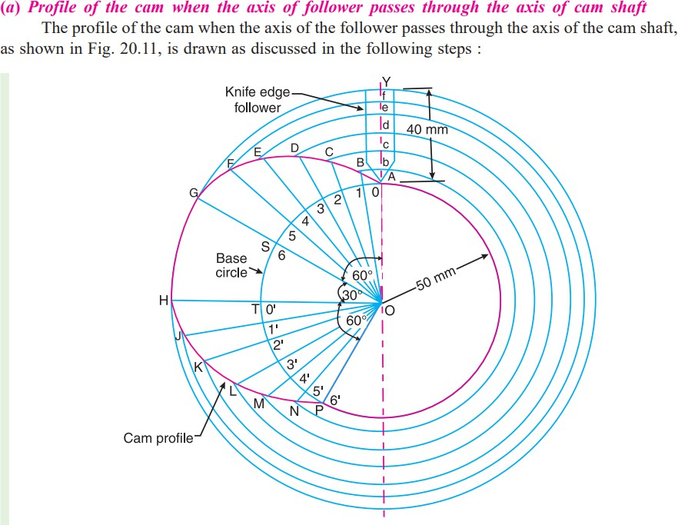

Slide 17
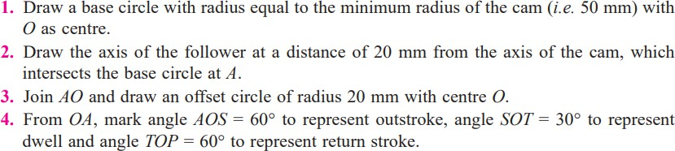
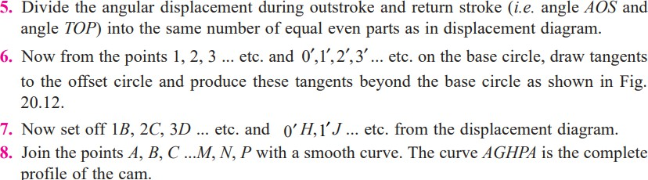

Slide 18
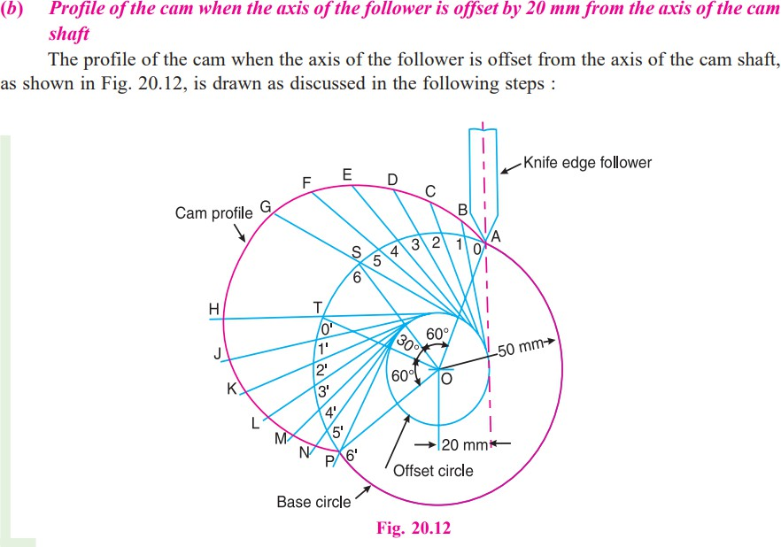

Slide 19
A cam is to be designed for a knife edge follower with the following data :
1. Cam lift = 40 mm during 90° of cam rotation with simple harmonic motion.
2. Dwell for the next 30°.
3. During the next 60° of cam rotation, the follower returns to its original position
with simple harmonic motion.
4. Dwell during the remaining 180°.
Draw the profile of the cam when
the line of stroke of the follower passes through the axis of the cam shaft, and
(b) the line of stroke is offset 20 mm from the axis of the cam shaft. The radius of the base circle of the cam is 40 mm.
Determine the maximum velocity and acceleration of the follower during its ascent and descent, if the cam rotates at 240 r.p.m.

Slide 20
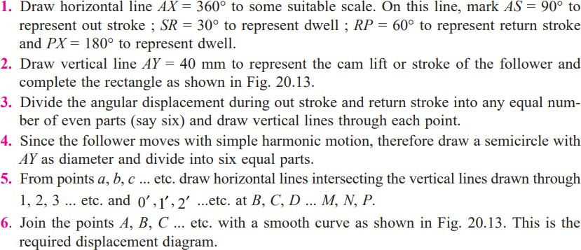

Slide 21
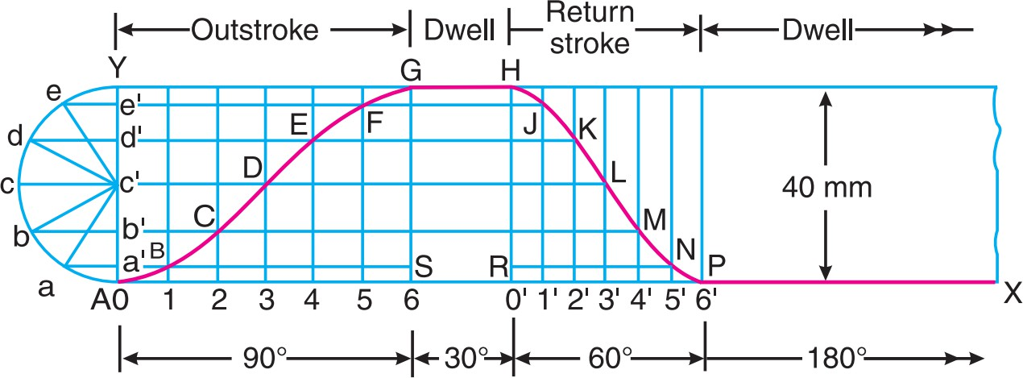

Slide 22
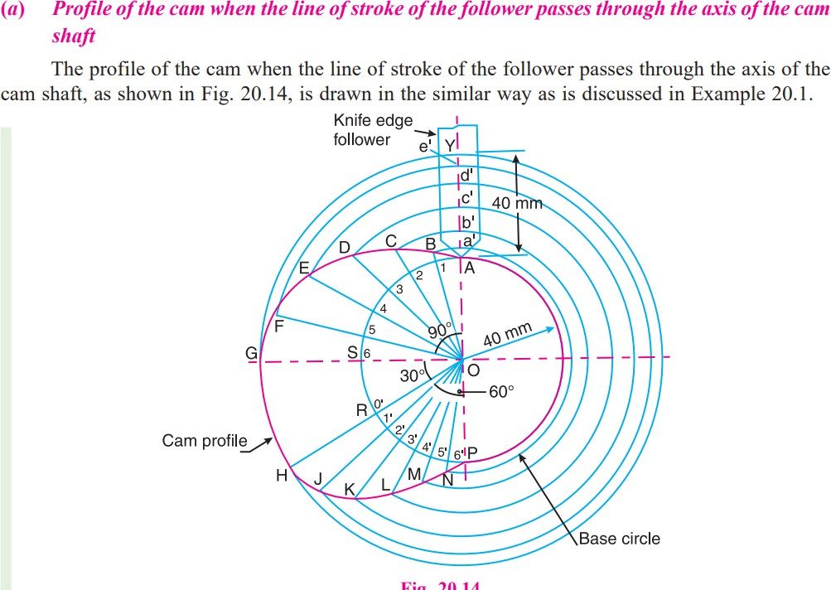

Slide 23
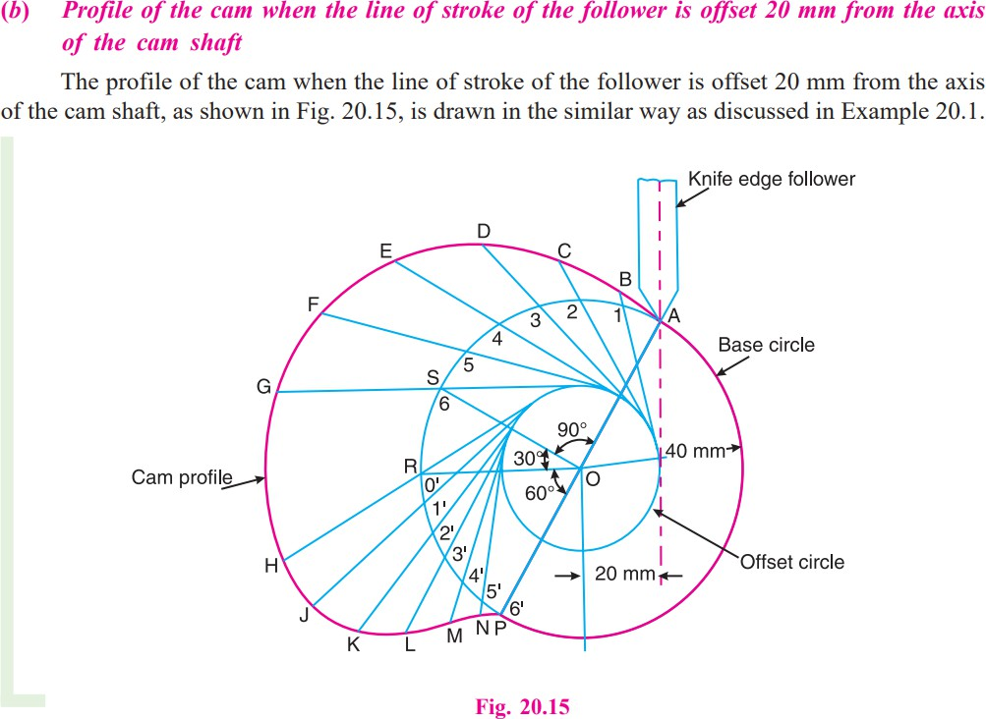

Slide 24
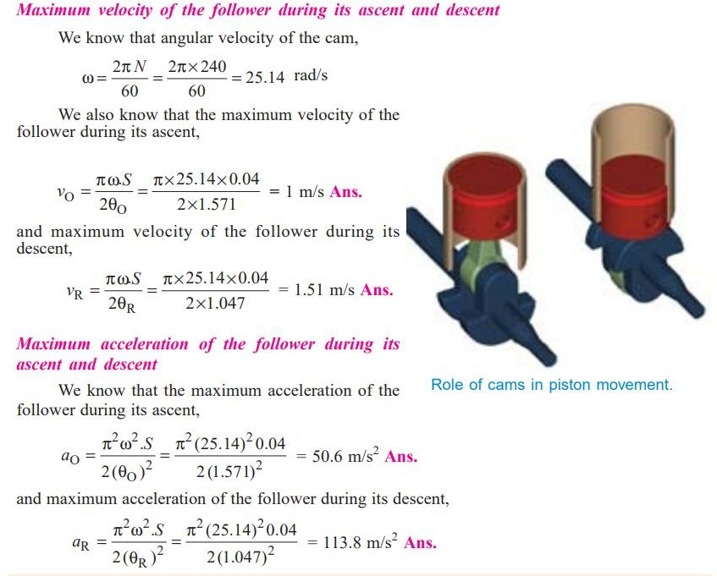

Slide 25
A cam, with a minimum radius of 25 mm, rotating clockwise at a uniform speed is to be designed to give a roller follower, at the end of a valve rod, motion described below :
1. To raise the valve through 50 mm during 120° rotation of the cam ;
2. To keep the valve fully raised through next 30°;
3. To lower the valve during next 60°; and
4. To keep the valve closed during rest of the revolution i.e. 150° ; The diameter of the roller is 20 mm and the diameter of the cam shaft is 25 mm.
Draw the profile of the cam when
(a) the line of stroke of the valve rod passes through the axis of the cam shaft, and
(b) the line of the stroke is offset 15 mm from the axis of the cam shaft. The displacement of the valve, while being raised and lowered, is to take place with simple harmonic motion. Determine the maximum acceleration of the valve rod when the cam shaft rotates at 100 r.p.m. Draw the displacement, the velocity and the acceleration diagrams for one complete revolution of the cam.

Slide 26
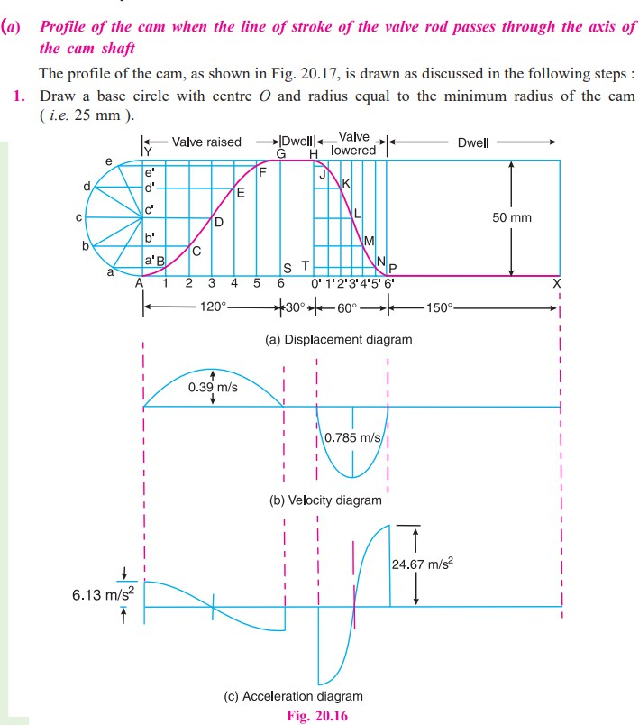

Slide 27
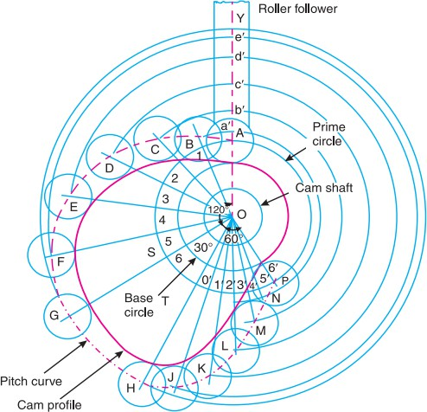

Slide 28
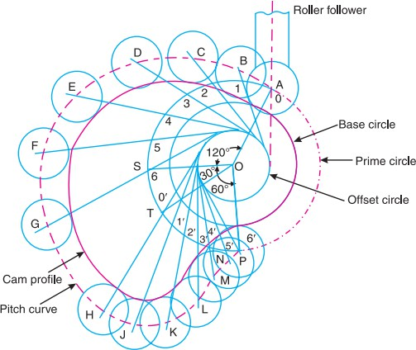

Slide 29
A cam drives a flat reciprocating follower in the following manner : During first 120° rotation of the cam, follower moves outwards through a distance of 20 mm with simple harmonic motion. The follower dwells during next 30° of cam rotation. During next 120° of cam rotation, the follower moves inwards with simple harmonic motion. The follower dwells for the next 90° of cam rotation. The minimum radius of the cam is 25 mm. Draw the profile of the cam.

Slide 30
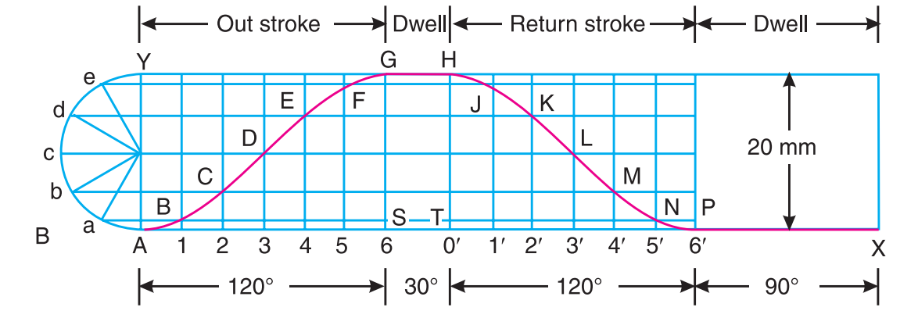
Displacement Diagram:

Slide 31
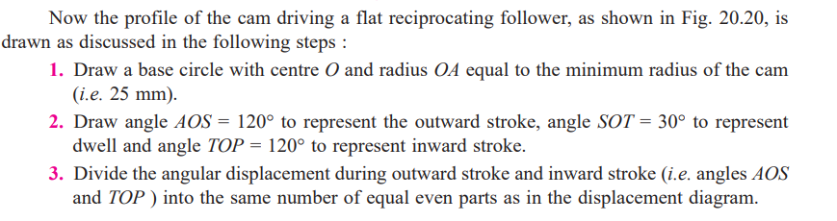
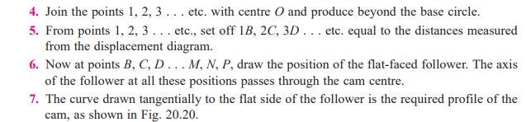

Slide 32
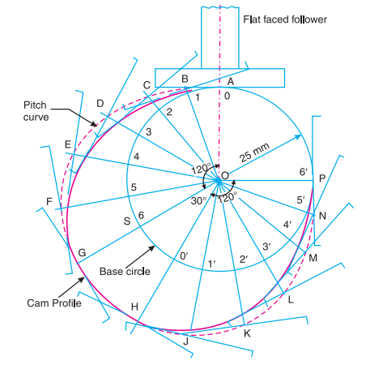

Slide 33
Draw a cam profile to drive an oscillating roller follower to the specifications given below : (a) Follower to move outwards through an angular displacement of 20° during the first 120° rotation of the cam ;
(b) Follower to return to its initial position during next 120° rotation of the cam ;
(c) Follower to dwell during the next 120° of cam rotation.
The distance between pivot centre and roller centre = 120 mm ; distance between pivot centre and cam axis = 130 mm ; minimum radius of cam = 40 mm ; radius of roller = 10 mm ; inward and outward strokes take place with simple harmonic motion.

Slide 34
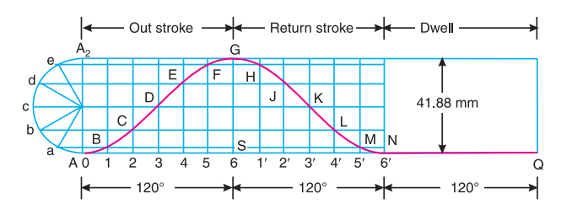

Slide 35
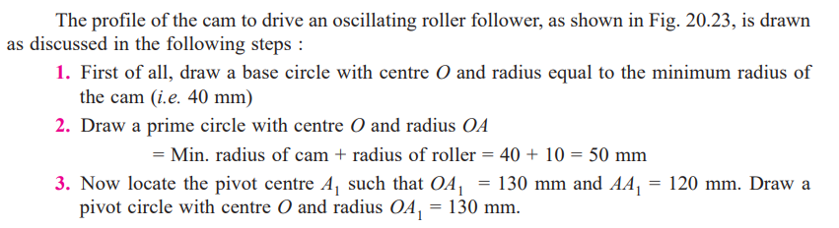
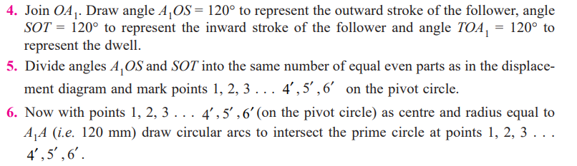
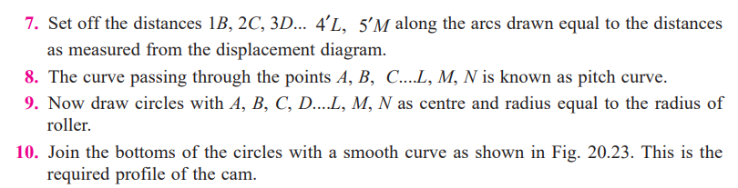

Slide 36
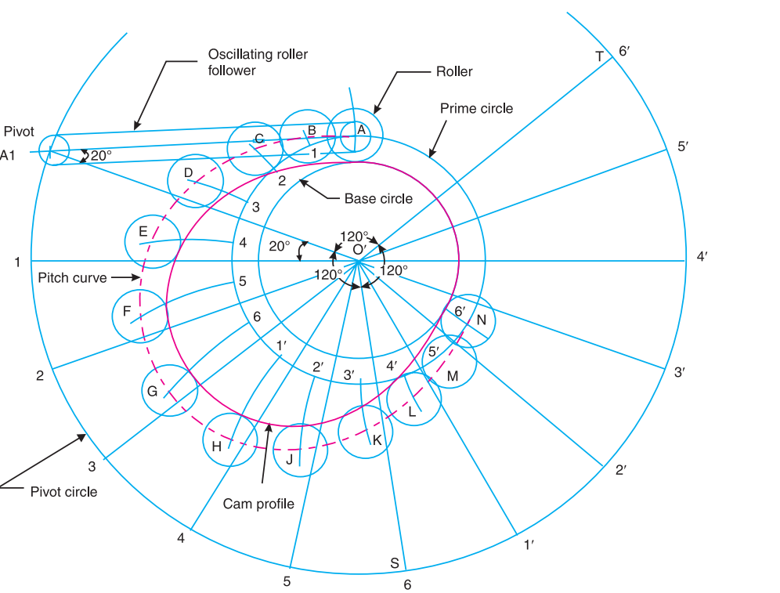

Slide 37
A cam, with a minimum radius of 50 mm, rotating clockwise at a uniform speed, is required to give a knife edge follower the motion as described below :
1. To move outwards through 40 mm during 100° rotation of the cam ;
2. To dwell for next 80° ;
3. To return to its starting position during next 90°, and
4. To dwell for the rest period of a revolution i.e. 90°.
Draw the profile of the cam
(i) when the line of stroke of the follower passes through the centre of the cam shaft, and
(ii) when the line of stroke of the follower is off-set by 15 mm.
The displacement of the follower is to take place with uniform acceleration and uniform retardation.
Determine the maximum velocity and acceleration of the follower when the cam shaft rotates at 900 r.p.m. Draw the displacement, velocity and acceleration diagrams for one complete revolution of the cam

Slide 38
Design a cam for operating the exhaust valve of an oil engine. It is required to give equal uniform acceleration and retardation during opening and closing of the valve each of which corresponds to 60° of cam rotation. The valve must remain in the fully open position for 20° of cam rotation. The lift of the valve is 37.5 mm and the least radius of the cam is 40 mm. The follower is provided with a roller of radius 20 mm and its line of stroke passes through the axis of the cam.

Slide 39
A cam rotating clockwise at a uniform speed of 1000 r.p.m. is required to give a roller follower the motion defined below :
1. Follower to move outwards through 50 mm during 120° of cam rotation,
2. Follower to dwell for next 60° of cam rotation,
3. Follower to return to its starting position during next 90° of cam rotation,
4. Follower to dwell for the rest of the cam rotation.
The minimum radius of the cam is 50 mm and the diameter of roller is 10 mm. The line of stroke of the follower is off-set by 20 mm from the axis of the cam shaft. If the displacement of the follower takes place with uniform and equal acceleration and retardation on both the outward and return strokes, draw profile of the cam and find the maximum velocity and acceleration during out stroke and return stroke.

Slide 40
Construct the profile of a cam to suit the following specifications with roller follower mechanism : Cam shaft diameter = 40 mm ; Least radius of cam = 25 mm ; Diameter of roller = 25 mm; Angle of lift = 120° ; Angle of fall = 150° ; Lift of the follower = 40 mm ; Number of pauses are two of equal interval between motions.
During the lift, the motion is S.H.M. During the fall the motion is uniform acceleration and deceleration. The speed of the cam shaft is uniform. The line of stroke of the follower is off-set 12.5 mm from the centre of the cam.

Slide 41
A cam operating a knife-edged follower has the following data :
(a) Follower moves outwards through 40 mm during 60° of cam rotation.
(b) Follower dwells for the next 45°.
(c) Follower returns to its original position during next 90°.
(d) Follower dwells for the rest of the rotation.
The displacement of the follower is to take place with simple harmonic motion during both the outward and return strokes. The least radius of the cam is 50 mm. Draw the profile of the cam when
1. the axis of the follower passes through the cam axis, and
2. the axis of the follower is offset 20mm towards right from the cam axis. If the cam rotates at 300 r.p.m., determine maximum velocity and acceleration of the follower during the outward stroke and the return stroke.
[Ans. 1.88 m/s, 1.26 m/s ; 177.7 m/s², 79 m/s²]

Slide 42
References: Theory of Machines by Khurmi

